Slide 1

SESSION 6:
Making Informed CDRF Decisions – Data, Financial Tools & Instruments: Practical Exercises with Models
Prof. Pierre LAZAMANANA
Professor of Economics
University of Antananarivo - Madagascar
CLIMATE & DISASTER RISK FINANCING ONLINE TRAINING

Slide 2
CLIMATE AND DISASTER RISK FINANCING ONLINE TRAINING
SESSION 6: Making Informed CDRF Decisions – Data, Financial Tools & Instruments: Practical Exercises with Models
PRESENTATION OUTLINE
Various types of data to be processed for the CDRF :
Introduction to CDRF data
HAZARD DATA: INTENSITY/MAGNITUDE; FREQUENCY; OCCURRENCE; RETURN PERIOD, ETC.
B. VULNERABILITY DATA: DATA ON THE DEGREE OF EXPOSURE TO VARIOUS TYPES OF HAZARDS
C. DISASTER RISK ASSESSMENT:
  C1. Probabilistic risk assessment;
    Data requirements :
    Examples of disaster risk assessment results: average annual loss (AAL) / probable maximum loss (PML)
  C2. Empirical disaster risk assessment
    Data requirements
    Data source

Slide 3


CLIMATE AND DISASTER RISK FINANCING ONLINE TRAINING
SESSION 6: Making Informed CDRF Decisions – Data, Financial Tools & Instruments: Practical Exercises with Models
Introduction:
3 key questions on data:
1
2
3
What type of data do you need?
Where can you find the data?
Is the data fit for purpose?
The value of analytics is only as good as the data that feeds into it

Slide 4





CLIMATE AND DISASTER RISK FINANCING ONLINE TRAINING
SESSION 6: Making Informed CDRF Decisions – Data, Financial Tools & Instruments: Practical Exercises with Models
I. What type of data do you need?
Risk / loss data
Macro-economic data
Fiscal / financial data
Big Data sets does not always equate to usable information

Slide 5





CLIMATE AND DISASTER RISK FINANCING ONLINE TRAINING
SESSION 6: Making Informed CDRF Decisions – Data, Financial Tools & Instruments: Practical Exercises with Models
II. Where can you find the data?
Government Agencies
Public Sources
Humanitarian Organizations
Risk Model Firms
Insurance Companies

Slide 6




CLIMATE AND DISASTER RISK FINANCING ONLINE TRAINING
SESSION 6: Making Informed CDRF Decisions – Data, Financial Tools & Instruments: Practical Exercises with Models
III. Is the data fit for purpose?
Adjustments to combine data from multiple sources
Scaling data to current time period
De-trending to remove trends in historical data over time
Removal of unreliable data points
Limitations of analysis given data fitness and appropriateness

Slide 7









CLIMATE AND DISASTER RISK FINANCING ONLINE TRAINING
SESSION 6: Making Informed CDRF Decisions – Data, Financial Tools & Instruments: Practical Exercises with Models
Analytics translates data into useful information
Data
Analytics
Information
Risk/Loss
Financial capacity building tools
For decision making
Macro-economic
Financial impact analysis
For monitoring & evaluation
Fiscal / Financial
Economic, fiscal evaluation
For capacity building

Slide 8
CLIMATE AND DISASTER RISK FINANCING ONLINE TRAINING
SESSION 6: Making Informed CDRF Decisions – Data, Financial Tools & Instruments: Practical Exercises with Models
The ‘financing gap’ = potential disaster losses minus available finance

Slide 9
CLIMATE AND DISASTER RISK FINANCING ONLINE TRAINING
SESSION 6: Making Informed CDRF Decisions – Data, Financial Tools & Instruments: Practical Exercises with Models
  HAZARD DATA:
  Intensity/magnitude, frequency/occurrence/return period, etc.
  National Disaster Risk profile:
  HAZARD DATA BASE TO BE EXPLAINED :
  www.desinventar.net
  www.emdat.be
  www.undrr.org

Slide 10
CLIMATE AND DISASTER RISK FINANCING ONLINE TRAINING
SESSION 6: Making Informed CDRF Decisions – Data, Financial Tools & Instruments: Practical Exercises with Models
  B. VULNERABILITY DATA: DATA ON THE DEGREE OF EXPOSURE TO VARIOUS TYPES OF HAZARD :
Detailed information on building construction for various categories: residential, commercial, industrial, public facilities (e.g. educational and training institutions and emergency facilities).
DATA SOURCES:
  www.worldbank.org/data/world
  Indicators related to vulnerabilities and exposures
  http://www.cepii.fr/DATA
  http://www.fao.org/faostat/en/#data/TM
  www.unysisweather.org (Satellite data)

Slide 11
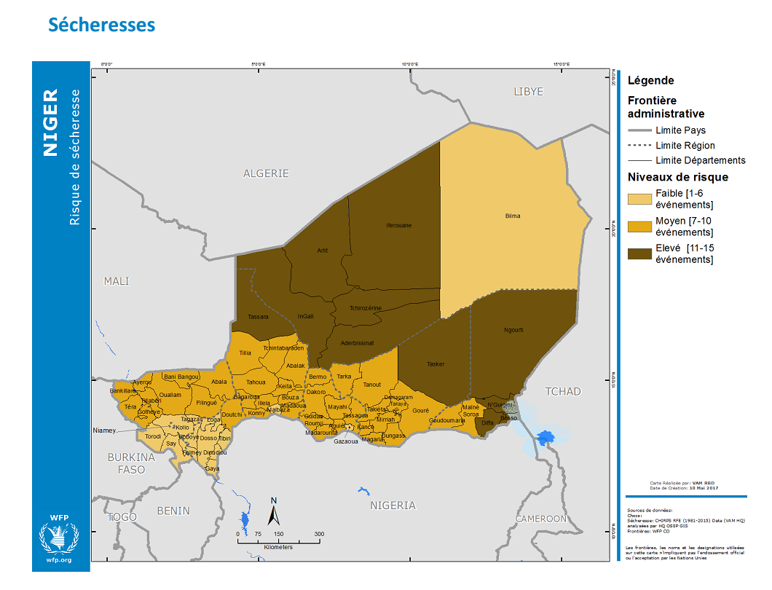
CLIMATE AND DISASTER RISK FINANCING ONLINE TRAINING
SESSION 5: The Use of Data in CDRF Including Satellite Data

Slide 12
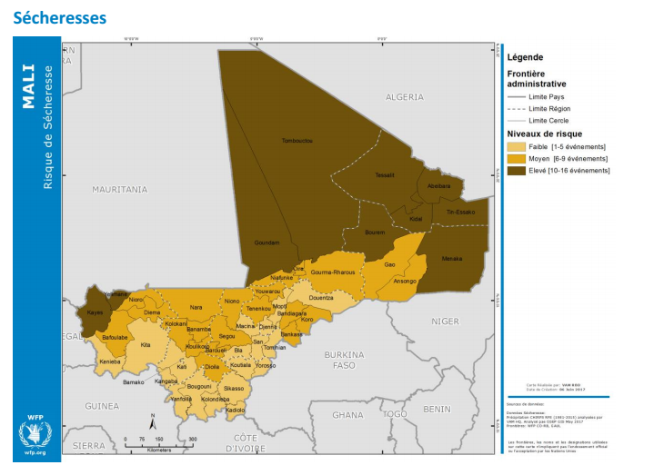
CLIMATE AND DISASTER RISK FINANCING ONLINE TRAINING
SESSION 5: The Use of Data in CDRF Including Satellite Data

Slide 13
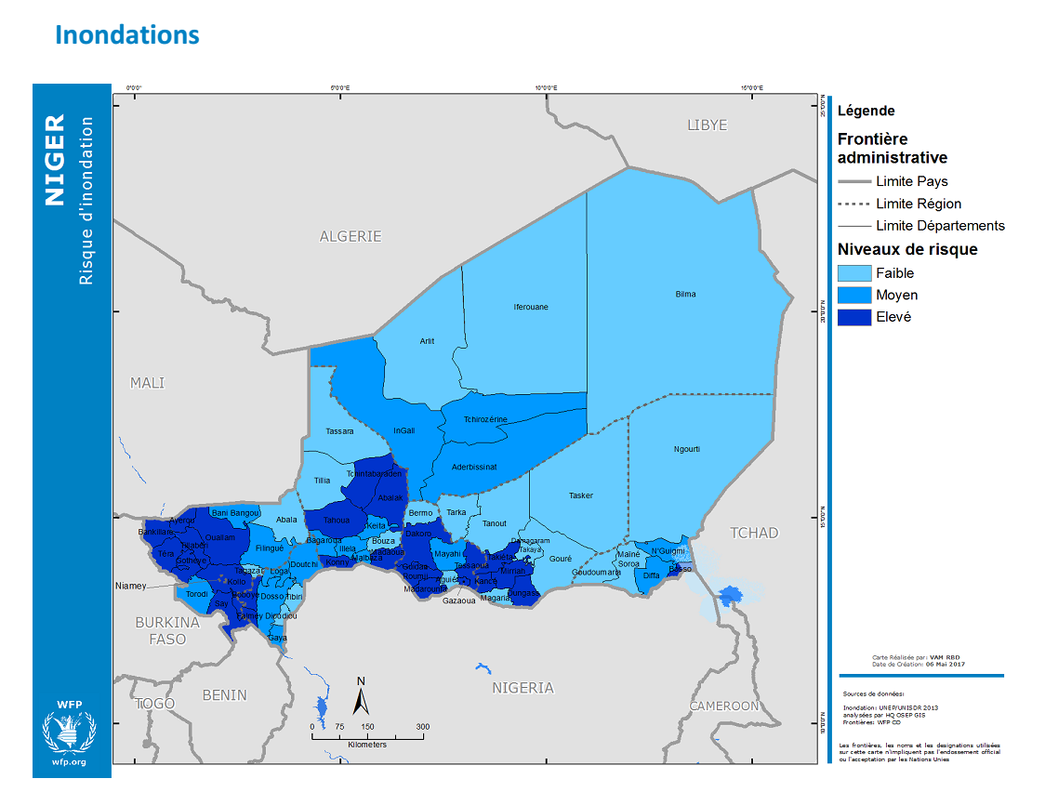
CLIMATE AND DISASTER RISK FINANCING ONLINE TRAINING
SESSION 5: The Use of Data in CDRF Including Satellite Data

Slide 14
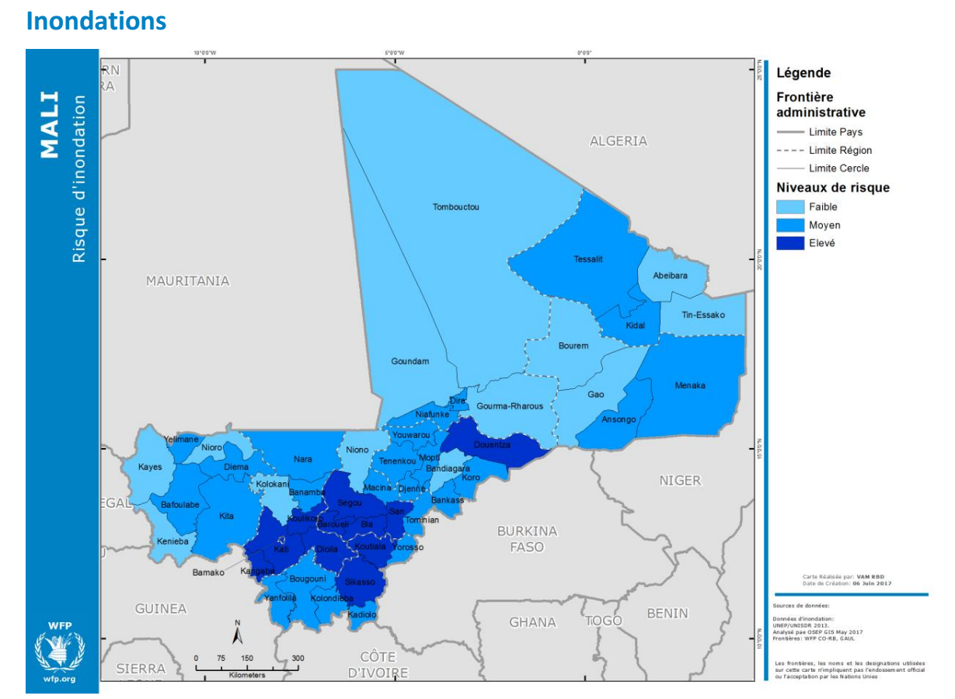
CLIMATE AND DISASTER RISK FINANCING ONLINE TRAINING
SESSION 5: The Use of Data in CDRF Including Satellite Data

Slide 15
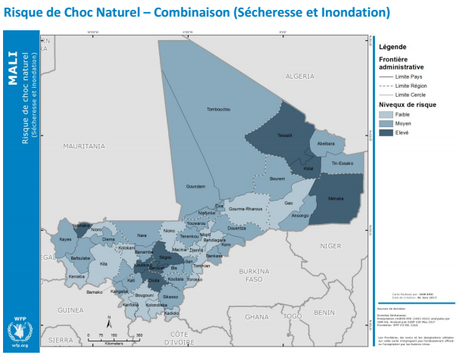
CLIMATE AND DISASTER RISK FINANCING ONLINE TRAINING
SESSION 5: The Use of Data in CDRF Including Satellite Data

Slide 16
CLIMATE AND DISASTER RISK FINANCING ONLINE TRAINING
SESSION 6: Making Informed CDRF Decisions – Data, Financial Tools & Instruments: Practical Exercises with Models
  C. DISASTER RISK ASSESSMENT :
    Probabilistic disaster risk assessment
    Empirical disaster risk assessment

Slide 17
CLIMATE AND DISASTER RISK FINANCING ONLINE TRAINING
SESSION 6: Making Informed CDRF Decisions – Data, Financial Tools & Instruments: Practical Exercises with Models
C1. EVALUATION PROBABILISTE DES RISQUES DE CATASTROPHES (PROBABILISTIC RISK ASSESSMENT) :
  a) Data requirements :
    Hazard data (see subsection above) ;
    Data on the degree of exposure of assets (e.g., excel files: commune/ municipality or Google Map/ google Earth/ GIS data etc.)
  b) Examples of disaster risk assessment results :

Slide 18
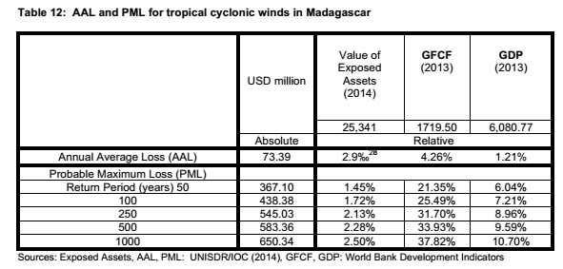
CLIMATE AND DISASTER RISK FINANCING ONLINE TRAINING
SESSION 6: Making Informed CDRF Decisions – Data, Financial Tools & Instruments: Practical Exercises with Models
  B) EXEMPLES DE RÉSULTATS D’ÉVALUATION DES RISQUES DE CATASTROPHES :

Slide 19
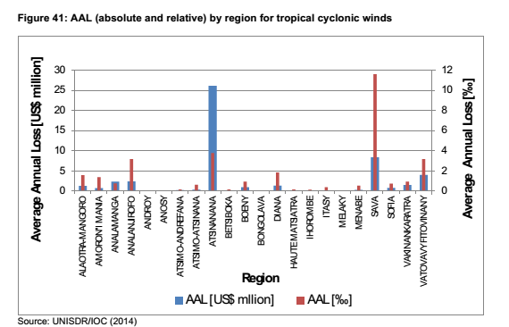
CLIMATE AND DISASTER RISK FINANCING ONLINE TRAINING
SESSION 5: The Use of Data in CDRF Including Satellite Data

Slide 20
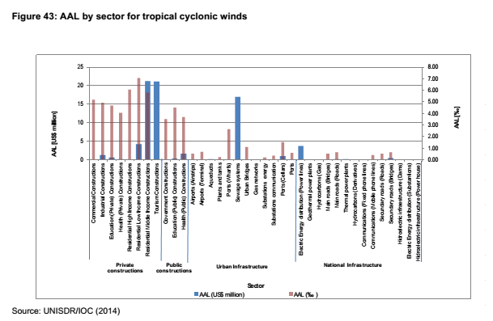
CLIMATE AND DISASTER RISK FINANCING ONLINE TRAINING
SESSION 5: The Use of Data in CDRF Including Satellite Data

Slide 21
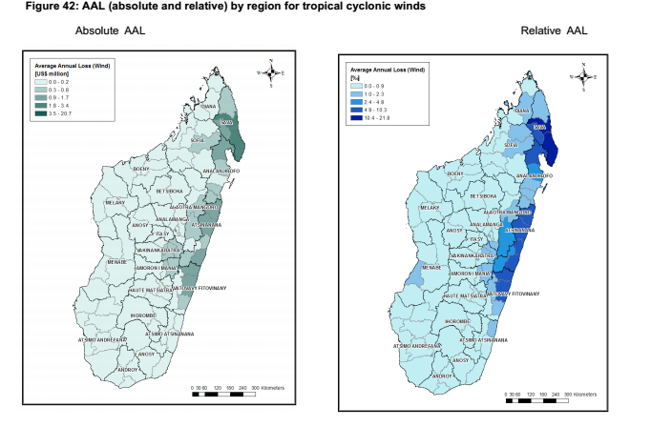
CLIMATE AND DISASTER RISK FINANCING ONLINE TRAINING
SESSION 5: The Use of Data in CDRF Including Satellite Data

Slide 22
CLIMATE AND DISASTER RISK FINANCING ONLINE TRAINING
SESSION 6: Making Informed CDRF Decisions – Data, Financial Tools & Instruments: Practical Exercises with Models
Presenting potential disaster losses – a Loss Exceedance Curve (LEC)
Type 2: x-axis showing return period = 1/probability
Type 1: x-axis showing probability

Slide 23
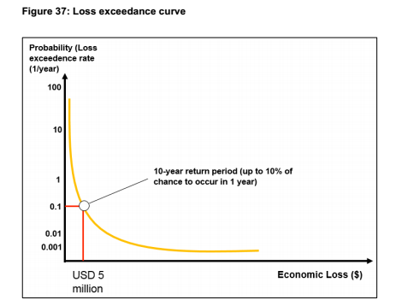
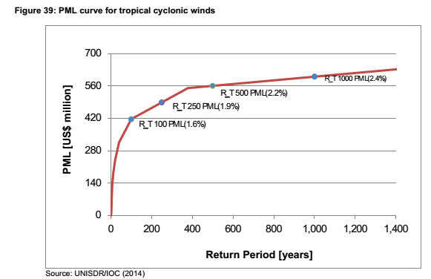
CLIMATE AND DISASTER RISK FINANCING ONLINE TRAINING
SESSION 6: Making Informed CDRF Decisions – Data, Financial Tools & Instruments: Practical Exercises with Models

Slide 24
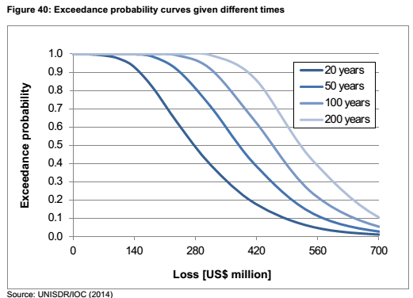
CLIMATE AND DISASTER RISK FINANCING ONLINE TRAINING
SESSION 6: Making Informed CDRF Decisions – Data, Financial Tools & Instruments: Practical Exercises with Models

Slide 25
CLIMATE AND DISASTER RISK FINANCING ONLINE TRAINING
SESSION 6: Making Informed CDRF Decisions – Data, Financial Tools & Instruments: Practical Exercises with Models
C2. EMPIRICAL DISASTER RISK ASSESSMENT
DATA NEEDED:
  Number and extent of damaged infrastructure
  Number and extent of damaged housing
  Amount of direct damage by sector (Agriculture, Education, Health, Public Works, Transport, Environment, Energy, Communications, Housing, Tourism, Economy, etc.);
  Others.
B. DATA SOURCES:
  www.desinventar.net
  www.emdat.be

Slide 26
CLIMATE AND DISASTER RISK FINANCING ONLINE TRAINING
SESSION 6: Making Informed CDRF Decisions – Data, Financial Tools & Instruments: Practical Exercises with Models
ABSTRACT
Effective financial planning for disasters requires good quality data and analysis
Limited data and some basic analysis may be sufficient to gain initial insights into potential disaster losses and start the planning process
Probabilistic risk assessment can provide a more accurate picture of potential losses, and is usually necessary for some financial products such as insurance

Slide 27
CLIMATE AND DISASTER RISK FINANCING ONLINE TRAINING
SESSION 6: Making Informed CDRF Decisions – Data, Financial Tools & Instruments: Practical Exercises with Models
GUEST SPEAKER:
Evie Calcutt – World Bank

Slide 28
CLIMATE AND DISASTER RISK FINANCING ONLINE TRAINING
SESSION 6: Making Informed CDRF Decisions – Data, Financial Tools & Instruments: Practical Exercises with Models
Discussion: Making informed CDRF decisions

Slide 29
CLIMATE AND DISASTER RISK FINANCING ONLINE TRAINING
SESSION 6: Making Informed CDRF Decisions – Data, Financial Tools & Instruments: Practical Exercises with Models

