Slide 1
SESSION 5: Introduction to Key Financial Instruments Prof. RANDRIANALIJAONA Tiana Mahefasoa Disaster Risk Governance and Sustainable Development Economist Development Centre of Economic Studies and Research University of Antananarivo - Madagascar
CLIMATE & DISASTER RISK FINANCING ONLINE TRAINING

Slide 2
Outline
CLIMATE AND DISASTER RISK FINANCING ONLINE TRAINING
SESSION 4: CLIMATE AND DISASTER RISK FINANCING and KEY FINANCIAL INSTRUMENTS
Risk transfer
Contingent lines of credit
Contingency fund
Innovative instruments
Budget reallocation

Slide 3
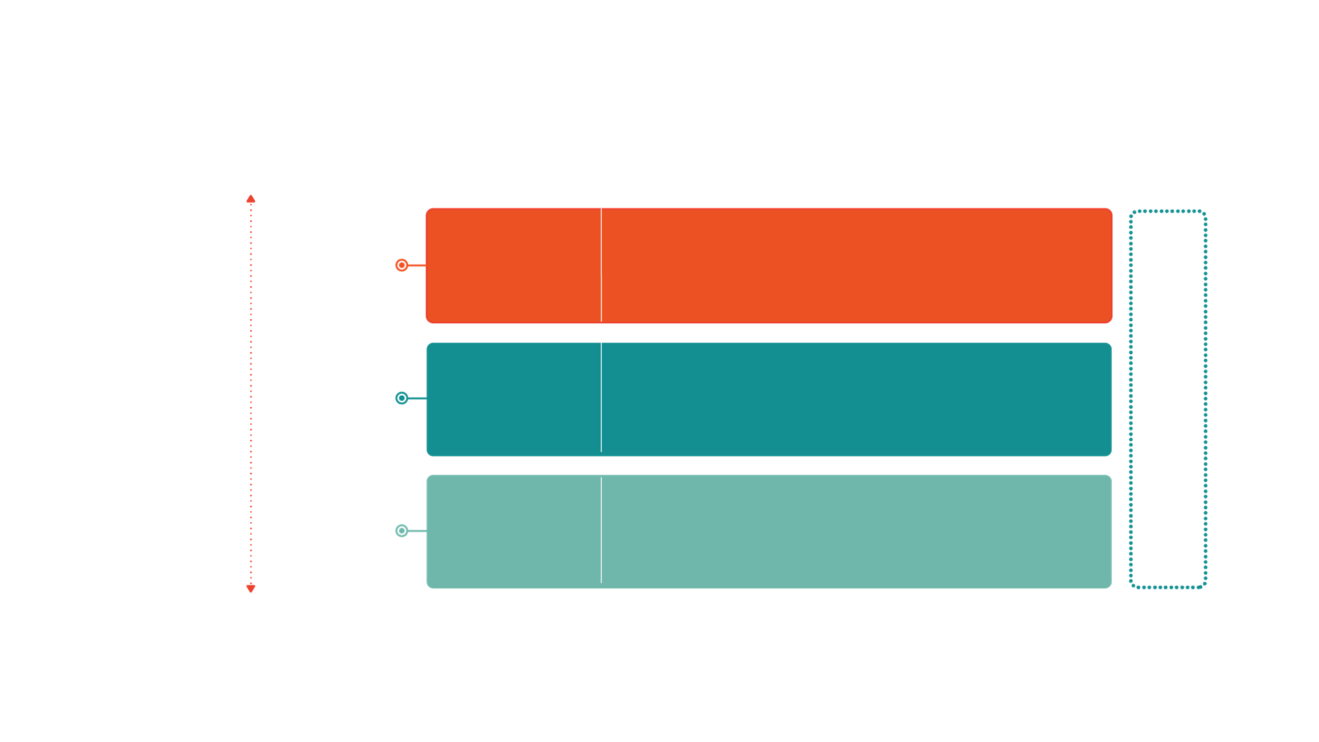
CLIMATE & DISASTER RISK FINANCING ONLINE TRAINING
SESSION 4 : Key financial instruments available which resonate with the African context
Core Principle 3: Disaster Risk Layering
No single Financial instrument can address all risks
HAZARD
TYPE
FINANCING INSTRUMENT
Low Frequency/
High Severity
Risk transfer for assets such as property insurance or agricultural insurance and risk transfer for budget management like paramedic insurance, cat bonds/swaps
Market-Based Instruments
Risk Transfer
Contingent Financing
Contingent Credit
Financial instruments that provide liquidity immediately after a shock
High Frequency/
Low Severity
Budgetary Instruments
Budget Reserves/
Reallocations
Reserve funds specifically designated for financing disaster related expenditures, general contingency budgets, or diverted spending from other programs

Slide 4
1) RISK TRANSFER
CLIMATE & DISASTER RISK FINANCING ONLINE TRAINING
SESSION 4 : Key financial instruments available which resonate with the African context
PRINCIPLES OF INSURANCE (RISK TRANSFER): An arrangement by which a company (or the state) undertakes to provide a guarantee of compensation for specified loss, damage, illness, or death in return for payment of a specified premium | TYPES OF COVERAGE : Indemnity cover: a guarantee to restore the insured to the position he or she was in before the uncertain incident that caused a loss for the insured Parametric cover: Index is created based on the severity of a specific natural hazard. If a hazard event occurs which exceeds a pre-defined threshold on the index (e.g. rainfall in province below 50 millimetres) a payout is triggered E.g : Agriculture insurance: can be parametric (based on an index) or indemnity (based on actual loss) Public asset insurance: indemnity insurance for key public assets (bridges, roads, power plants
KEY PROVIDERS : Domestic insurance companies, International reinsurance companies, Sovereign Risk Pools: Countries can pool risks in a diversified portfolio, retain some of the risk through joint reserves and capital, and transfer excess risk to the reinsurance and capital market | BEST SUITED: High-risk layer In the case of the lower-risk layer, where costs are smaller and more frequent, it is inefficient to pay an additional premium to cover these costs.

Slide 5
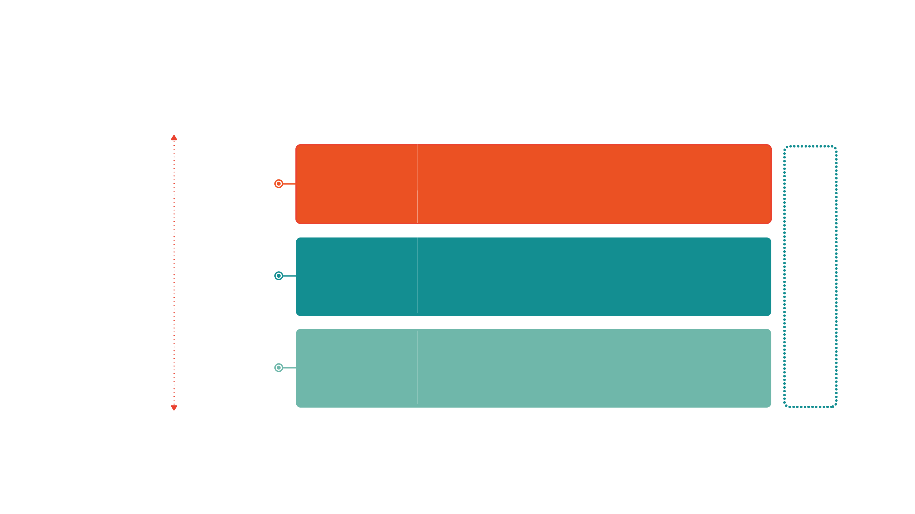
CLIMATE AND DISASTER RISK FINANCING ONLINE TRAINING
SESSION 4: CLIMATE AND DISASTER RISK FINANCING and KEY FINANCIAL INSTRUMENTS
Parametric insurance as one component of a DRF strategy
Hazard Type
Financing instrument
Market-Based Instruments
Risk Transfer
Risk transfer for assets such as property insurance or agricultural insurance and risk transfer for budget management like parametric insurance, cat bonds/swaps
Low Frequency/
High Severity
Contingent Financing
Contingent Credit
Financial instruments that provide liquidity immediately after a shock
International Assistance (uncertain)
High Frequency/
Low Severity
Budget Reserves/
Reallocations
Reserve funds specifically designated for financing disaster related expenditures, general contingency budgets, or diverted spending from other programs
Budgetary Instruments

Slide 6
2) CONTINGENT LINES OF CREDIT
CLIMATE AND DISASTER RISK FINANCING ONLINE TRAINING
SESSION 4: CLIMATE AND DISASTER RISK FINANCING and KEY FINANCIAL INSTRUMENTS
Definition and how it works A contingent line of credit is line of credit (loan) which is disbursed to a country upon the occurrence of a pre-defined shock. The terms and conditions of the loan (loan amount, fees, interest rate, duration, etc.) : Agreed upon signing the loan agreement, prior to the disaster. Objective : to provide liquidity to the benefiting country immediately after a shock (natural hazard induced disasters / health-related emergencies). The loan resources can be disbursed to the benefiting country as budget support (as a development policy loan, in exchange for systemic and institutional improvements to strengthen financial resilience) or against pre-agreed expenditures (investment operation).

Slide 7
2) CONTINGENT LINES OF CREDIT
CLIMATE & DISASTER RISK FINANCING ONLINE TRAINING
SESSION 4 : Key financial instruments available which resonate with the African context
BEST SUITED Possibility to have concessional financing terms given they are negotiated before a shock occurs and are offered by multilateral development banks. They therefore tend to be lowcost financing instruments, effective for financing response to moderate frequency, severity shocks. | IMPACTS ON DEVELOPMENT GOALS In the case of budget support loans, possibility to link them to a robust matrix of policy reforms which the beneficiary country must undertake to receive the loan (as with development policy operation). In the case of investment operations, the funds can be used to pay eligible expenditures which contribute to the attainment of development objective of the country.
ADVANTAGES Rapid access to funding in the event of a disaster / public health emergency / macro shocks, Supporting key reforms that strengthen the country’s ability to manage the impacts of disasters on the economy and the vulnerable. | DISADVANTAGES AND/OR CONSTRAINTS Completion of a limited set of prior actions and satisfactory implementation of a Disaster Risk Management (DRM) program, The Development Bank will monitor on a periodic basis, and x keep an appropriate macroeconomic policy framework

Slide 8
3) CONTINGENCY FUNDS
CLIMATE & DISASTER RISK FINANCING ONLINE TRAINING
SESSION 4 : Key financial instruments available which resonate with the African context
NATIONAL FUNDS TO FINANCE PREPAREDNESS, EMERGENCY RESPONSE AND RECOVERY ACTIVITIES. Considered as relatively low-cost risk financing instruments and immediately available, they allow national and local agencies to develop realistic contingency plans. Such funds enable Governments to rapidly access resources to respond to a shock, which can avoid bureaucratic delays (need for verification, administrative accounting, disbursement scheduling, etc.). Rules under which these funds are managed are so important to ensure they are available timely. In many countries contingency funds exist, however the conditions under which they disburse are vaguely written and often broad. In such instances, it can be a challenge to ensure sufficient funds are available which a shock occurs, especially when shocks occur later in the budgetary cycle, as the funds can be depleted.
Contingency funds and contingency plan ?!?

Slide 9
4) INOVATIVE FUNDS INSTRUMENTS
CLIMATE & DISASTER RISK FINANCING ONLINE TRAINING
SESSION 4 : Key financial instruments available which resonate with the African context
Forecast Based Financing (FBF) : A system to fill gaps in the humanitarian system by using in-depth weather forecast information to anticipate possible impacts in risk-prone areas and mobilize resources automatically before an event. The goal of FbF is to anticipate disasters, prevent their negative impacts and, if possible, reduce human suffering. FbF system allows humanitarian responders, meteorological services and communities to agree on selected actions that are worth carrying out once a forecast reaches a certain threshold of probability. Each action is allocated a budget and funds are disbursed once the threshold is reached, according to predefined standard operational procedures.
Fiscal measures (tax policy at national or subnational level) To Incentives to sensitize private sector to engage more actively in supporting DRR and DRM, And also play important role to supporting relief and emergency response : Tax rate decrease/exemption if contributing to relief (tax policy based on certain defined amount of contribution) | Tax policy at local level (municipality) as Adaptation and/or mitigation measures to climate changes impacts Disaster Risk Reduction incentives/contribution For better land use planning ➔ very powerful tools and internal funding source of CDRF ➔ Disasters could/should be considered as opportunity to advance sustainable development by the means of CDRF

Slide 10
CLIMATE AND DISASTER RISK FINANCING ONLINE TRAINING
SESSION 4: CLIMATE AND DISASTER RISK FINANCING and KEY FINANCIAL INSTRUMENTS
APOLOGIES IN ADVANCE
the English interpreter had a poor connection making some of the interpretation not as audible or clear as desired

Slide 11
CLIMATE AND DISASTER RISK FINANCING ONLINE TRAINING
SESSION 4: CLIMATE AND DISASTER RISK FINANCING and KEY FINANCIAL INSTRUMENTS
Budget reallocation or redesign as a tool for climate change financing and disaster risk management
Ultimate goal of financial instruments: financial resilience
Simply put, it is the ability to meet the expenses related to climate change and disaster risk management.

Slide 12
CLIMATE AND DISASTER RISK FINANCING ONLINE TRAINING
SESSION 4: CLIMATE AND DISASTER RISK FINANCING and KEY FINANCIAL INSTRUMENTS
Issues and challenges of climate change
and climate disaster risk:
Climate-induced disasters interrupt or slow economic growth by, among other things:
Destroying both public and private infrastructure, and
causing direct physical damage that contributes to the decrease of the GDP (destruction of factories, hotels, means of production, trade, houses that serve as a place of productive activities) etc.
Leading to indirect macroeconomic losses.

Slide 13
CLIMATE AND DISASTER RISK FINANCING ONLINE TRAINING
SESSION 4: CLIMATE AND DISASTER RISK FINANCING and KEY FINANCIAL INSTRUMENTS
Macroeconomic indirect losses from climate change
and disaster risks can be:
The decline in current account transactions, particularly because of the decline in agricultural exports (cocoa, vanilla, corn, rice, etc.)
The increase in the import of food products,
The decrease in income from tourism services (hotels, restaurants, transport, trade in handicrafts, etc.)
The loss of tax revenue due to exemptions for food imports that are exempt from import duties and taxes in order to meet emergency and recovery needs
The decline in budget revenues and the increase in budget expenditures, which increases the budget deficit.

Slide 14
CLIMATE AND DISASTER RISK FINANCING ONLINE TRAINING
SESSION 4: CLIMATE AND DISASTER RISK FINANCING and KEY FINANCIAL INSTRUMENTS
Climate change and DRR/CRM result in various types of expenditures, including adaptation, prevention, mitigation, preparedness, emergency, recovery, reconstruction, etc.
Sector Ministry/ Institution | Response | Rehabilitation | Reconstruction
Ministry of Finance and Budget | - | 100,00% | -
National Risk and Disaster Office (BNGRC) | 99,40% | 0,60% | -
Presidency | 78,60% | 0,60% | 20,90%
Prime Minister's Office | 24,40% | 75,60% | -
Ministry of Public Works | - | 100,00% | -
Ministry of Water and Sanitation | - | 100,00% | -
Ministry of Agriculture and Rural Development | 100,00% | - | -
Ministry of Public Health | 100,00% | - | -
Ministry of Population, Social Protection and Women's Protection | 100,00% | - | -
Average | 50,00% | 44,90% | 5,10%

Slide 15
CLIMATE AND DISASTER RISK FINANCING ONLINE TRAINING
SESSION 4: CLIMATE AND DISASTER RISK FINANCING and KEY FINANCIAL INSTRUMENTS
Budget reallocations are often made because pre-established budget lines to address emergency disaster needs are virtually non-existent during budget planning.
Post-Disaster Expenditures by Category and Institution and Sector Ministry 2015- Madagascar
Sector Ministry/ Institution | Budget line dedicated to disaster spending | Budget reallocation/ reorganization | Donations from fundraising | From the Diaspora | Donations from development partners, channeled through the Government | Total | Total (US Dollar)
Ministry of Finance and Budget |  | 100% |  |  |  | 100% | 5 806 161
National Risk and Disaster Office (BNGRC) | 20% | 59% | 7% | 0% | 14% | 100% | 4 755 598
Presidency |  | 100% |  |  |  | 100% | 4 305 358
Prime Minister's Office |  | 5% |  |  | 95% | 100% | 1 069 883
Ministry of Public Works |  | 0% | 0% | 0% | 100% | 100% | 676 616
Ministry of Water and Sanitation |  | 100% |  |  |  | 100% | 498 351
Ministry of Agriculture and Rural Development |  | 95% |  |  | 5% | 100% | 283 227
Ministry of Public Health |  | 100% |  |  |  | 100% | 72 054
Ministry of Population, Social Protection and Women's Protection |  | 100% | 0% | 0% | 0% | 100% | 3 456
Sources of funding for post-disaster expenditures, by institution and sector ministry Madagascar 2015

Slide 16
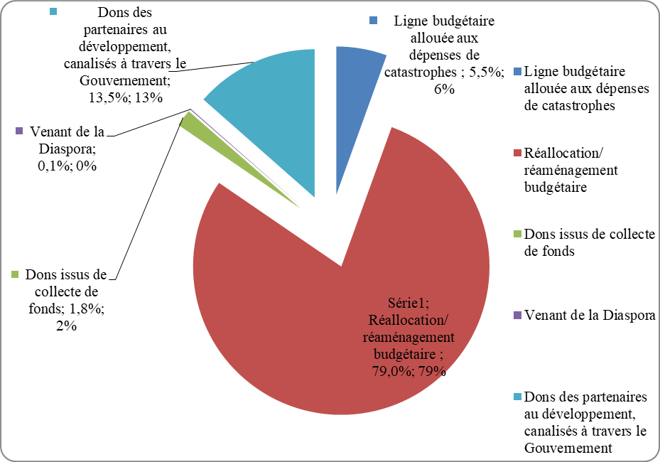
CLIMATE AND DISASTER RISK FINANCING ONLINE TRAINING
SESSION 4: CLIMATE AND DISASTER RISK FINANCING and KEY FINANCIAL INSTRUMENTS
Budget reallocations are often made because pre-established budget lines to address emergency disaster needs are virtually non-existent during budget planning (continued).
Donations from development partners, channeled through the government; 13.5%; 13%.
Budgetary allocations for disaster spending; 5.5%; 6%.
from the diaspora
0.1% ; 0%
Reallocation of budgetary reorganization
79.0%
Donations from fundraising activities:
1.8% ; 2%
Source: Ministry of Finance and Budget/Directorate General of the Budget. Budget execution monitoring document, first quarter 2015.

Slide 17
CLIMATE AND DISASTER RISK FINANCING ONLINE TRAINING
SESSION 4: CLIMATE AND DISASTER RISK FINANCING and KEY FINANCIAL INSTRUMENTS
Negative effects of budget reallocations:
Tax exemptions, particularly for disaster response and rehabilitation activities, reduce tax revenues.
Losses in budgetary revenues lead to a decline in total government revenues.
Budgetary reallocation disrupts development efforts because it not only changes the order of priority of planned activities, but also does not allow for the full implementation of disaster response, recovery and reconstruction activities, given the lack of resources to meet emergency needs.

Slide 18
CLIMATE AND DISASTER RISK FINANCING ONLINE TRAINING
SESSION 4: CLIMATE AND DISASTER RISK FINANCING and KEY FINANCIAL INSTRUMENTS
Negative effects of budget reallocations:
The reallocation or rearrangement of the budget between different budget lines increases the amount of budgetary expenditure and amplifies the budget deficit since the expenditure incurred as a result of the disasters is not initially foreseen and included in the state budget during budget planning.
Conclusion: public spending related to CC and climate disaster risks disrupts public finances since these fiscal impacts only increase the public deficit.

Slide 19
CLIMATE AND DISASTER RISK FINANCING ONLINE TRAINING
SESSION 4: CLIMATE AND DISASTER RISK FINANCING and KEY FINANCIAL INSTRUMENTS
APPLICATION REFLECTION
Considered vulnerable to climate change, the P country with its 4 provinces is located in the region and is highly exposed to disaster risks. GROUP 1: A flood with a return period of 15 years has just hit 2 provinces, one of which is highly populated and the other the most efficient in terms of agricultural production, causing an almost total immobilisation of the latter for 4 days. | Considered vulnerable to climate change, the country P with its 4 provinces is located in the region and is highly exposed to disaster risks. GROUP 2 AND 3 : Precisely because of climate change, heavy rains - which normally cause floods with a return period of 50 years - arrive and affect a heavily agricultural province with the characteristics of a 100-year flood. In addition, the problem is exacerbated by the lack of an adequate water management plan and WASH problems.
CONSEQUENCES: enormous damage to assets (including 5 bridges, 10 schools, 3 health facilities and a hydroelectric dam which is the only source of electricity for the country's 2 provinces, 30% of agricultural land completely flooded for a week) and losses estimated at USD 100 million RESOURCES: - contingency fund US$ 20 million possibility of additional emergency funds from the Ministry of Finance $10 million climate finance fund: US$ 8 million As a group of experts, you are asked to support the reflection on the design of an action plan that the authorities are currently devising to deal with this disaster with a vision of sustainable development? | CONSEQUENCES: enormous damage to assets (including 8 bridges, 8 schools, 5 health facilities and 2 hydroelectric dams, 50% of agricultural land completely flooded for 2 weeks) and losses estimated at 300 million USD RESOURCES: - contingency fund US$ 25 million possibility of additional emergency funds from the Ministry of Finance $15 million climate finance fund: US$ 12 million As a group of experts, you are asked to support the reflection on the design of an action plan that the authorities are currently devising to deal with this disaster with a vision of sustainable development?

Slide 20
CLIMATE AND DISASTER RISK FINANCING ONLINE TRAINING
SESSION 4: CLIMATE AND DISASTER RISK FINANCING and KEY FINANCIAL INSTRUMENTS
In the next few minutes you will be placed in a breakout room to discuss your assigned topic
Please select “Join” when you are ready to enter the room
After 20 minutes you will be returned to the main session automatically

Slide 21
CLIMATE AND DISASTER RISK FINANCING ONLINE TRAINING
SESSION 4: CLIMATE AND DISASTER RISK FINANCING and KEY FINANCIAL INSTRUMENTS
GROUP FEEDBACK
and
DISCUSSION

Slide 22
CLIMATE AND DISASTER RISK FINANCING ONLINE TRAINING
SESSION 4: CLIMATE AND DISASTER RISK FINANCING and KEY FINANCIAL INSTRUMENTS

