Slide 1

SESSION 4:
Fundamentals of Disaster Risk Financing : key concepts and principles
Dr Elizabeth Nanziri
Stellenbosch University Business School
CLIMATE & DISASTER RISK FINANCING ONLINE TRAINING

Slide 2
WHAT IS DISASTER RISK FINANCE?
CLIMATE AND DISASTER RISK FINANCING ONLINE TRAINING
SESSION 4: FUNDAMENTALS OF CDRF
Protecting livelihoods and development
Increasing the Financial Resilience of the national and subnational governments, businesses, households, farmers, and the most vulnerable against natural disasters by implementing sustainable and cost-effective financial protection policies and operations.

Slide 3
WHAT IS DISASTER RISK FINANCE?
CLIMATE AND DISASTER RISK FINANCING ONLINE TRAINING
SESSION 4: FUNDAMENTALS OF CDRF
Ensuring money reaches people who need it the most, when they need it the most
Using Financial Planning to protect Investments in human development and productive assets
X Adapting to long-term climate changes and trends
Planning on how to meet the cost of disasters before they happen

Slide 4
WHAT IS DISASTER RISK FINANCE?
CLIMATE AND DISASTER RISK FINANCING ONLINE TRAINING
SESSION 4: FUNDAMENTALS OF CDRF
Increasing the speed, predictability and transparency of disaster response
X Raising funds from International partners after a disaster
X Financing risk reduction and development

Slide 5

CLIMATE AND DISASTER RISK FINANCING ONLINE TRAINING
SESSION 4: FUNDAMENTALS OF CDRF
Four groups of people often impacted by natural hazard related disasters and climate risk events
GOVERNMENT
Households / business owner
PEASANTS
THE POOREST

Slide 6

CLIMATE AND DISASTER RISK FINANCING ONLINE TRAINING
SESSION 4: FUNDAMENTALS OF CDRF
Core Principle 1
Timeliness of funding
Resource Requirements ($)
Relief
Recovery
Reconstruction
Speed matters, but resources need to be allocated efficiently and properly.

Slide 7
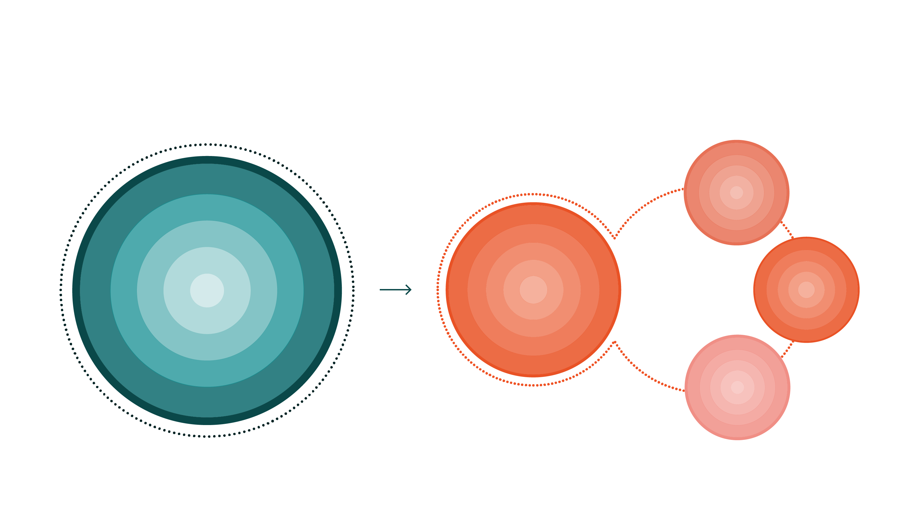
CLIMATE AND DISASTER RISK FINANCING ONLINE TRAINING
SESSION 4: FUNDAMENTALS OF CDRF
Core Principle 2
How money reaches beneficiaries is as important as where it comes from
Public
Services
      $
Government DRF Strategy
Livelihood Support
Public Assets

Slide 8
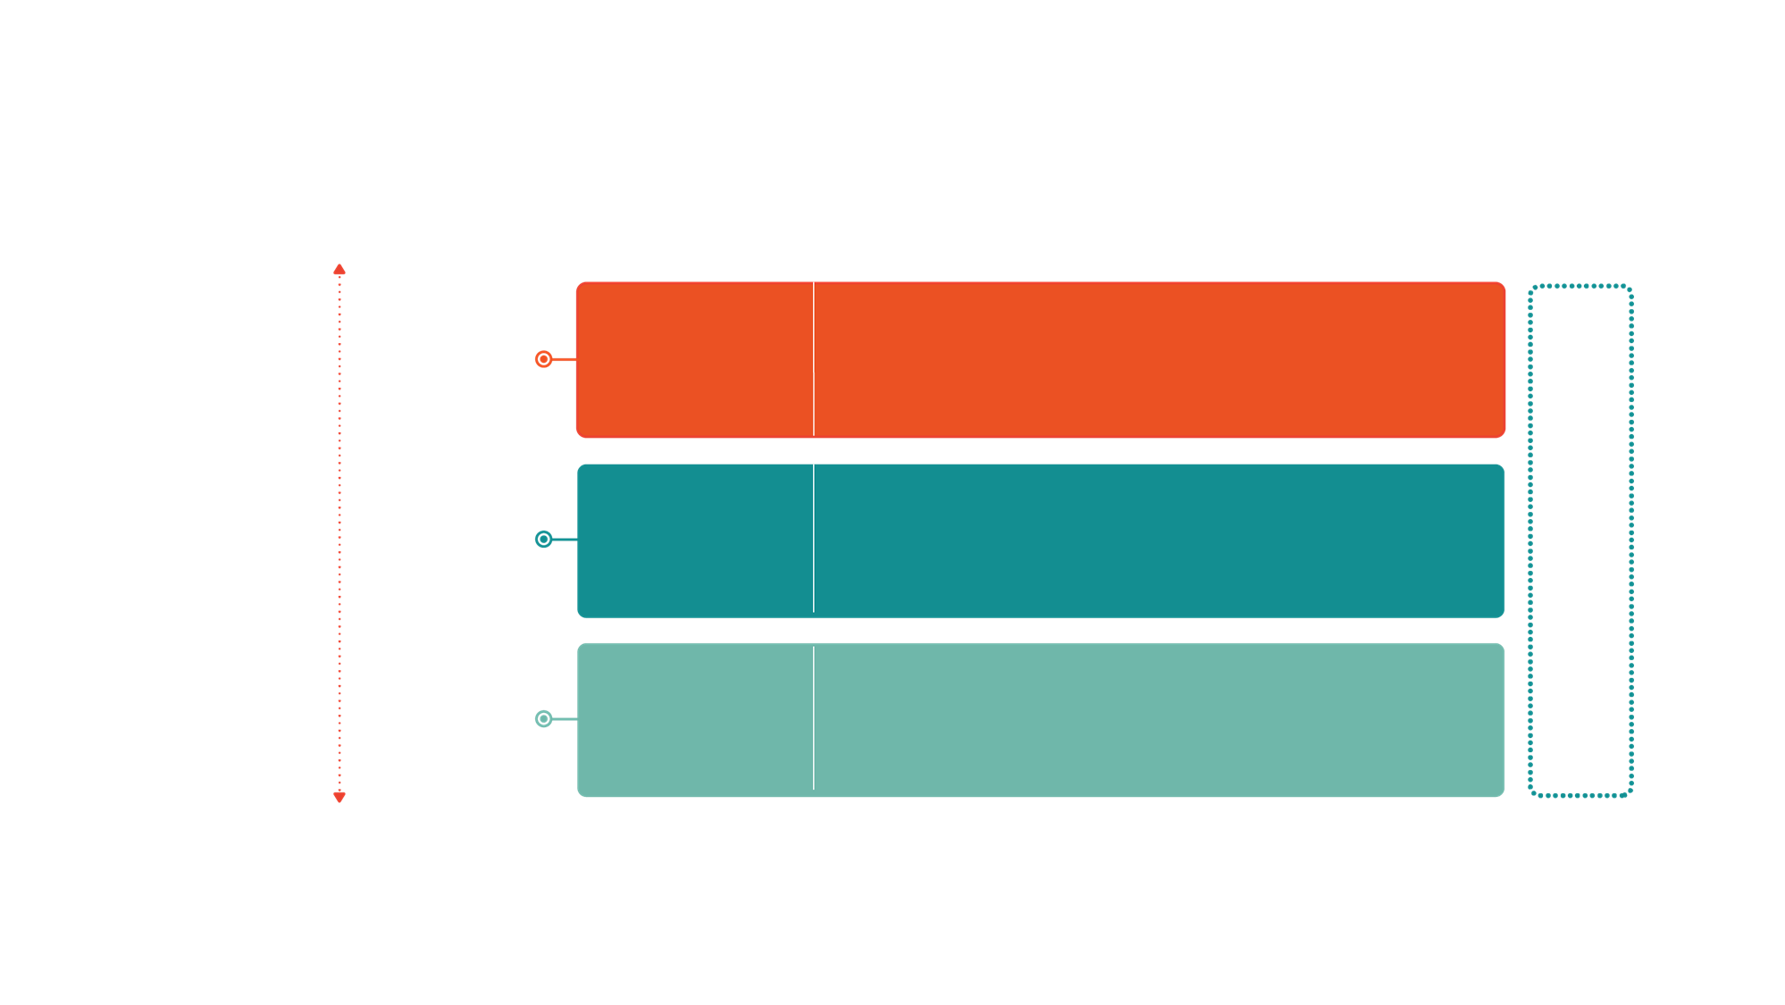
CLIMATE AND DISASTER RISK FINANCING ONLINE TRAINING
SESSION 4: FUNDAMENTALS OF CDRF
Core Principle 3: Disaster Risk Layering
No single Financial instrument can address all risks
HAZARD
TYPE
FINANCING INSTRUMENT
Low Frequency/
High Severity
Risk transfer for assets such as property insurance or agricultural insurance and risk transfer for budget management like paramedic insurance, cat bonds/swaps
Market-Based Instruments
Risk Transfer
Contingent Financing
Contingent Credit
Financial instruments that provide liquidity immediately after a shock
High Frequency/
Low Severity
Budgetary Instruments
Budget Reserves/
Reallocations
Reserve funds specifically designated for financing disaster related expenditures, general contingency budgets, or diverted spending from other programs

Slide 9
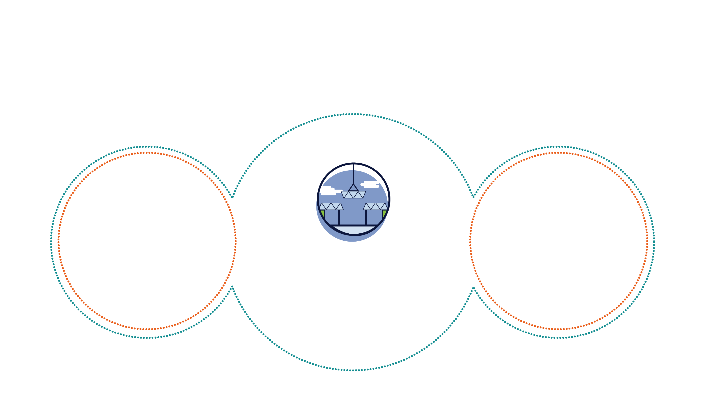
CLIMATE AND DISASTER RISK FINANCING ONLINE TRAINING
SESSION 4: FUNDAMENTALS OF CDRF
Core Principle 4: Data and Analytics
The right information for sound Financial Decisions
DRFI
ANALYTICS
    Understanding Financial
    Impact of Disasters
    Make evidence based
    financial decisions
    Leverage private financial
    markets using quantitative outputs
    Monitor and evaluate
    DFRI strategies
    Loss Data (Historical
    Data/CAT Risk Model
    Microeconomic Data
    Financial and other Data
    Quantitative Analytics
    Financial Decision Making Tools
    Financial Impact Analysis
    Cost Benefit Analysis

Slide 10




CLIMATE AND DISASTER RISK FINANCING ONLINE TRAINING
SESSION 4: FUNDAMENTALS OF CDRF
Timeliness of Funding
No One Financial Instrument
Can Address All Risks
Remember
Four Core Principles
of DRF
How money reaches beneficiaries is as important as where it comes from
To make sound financial decisions you need to have the right information

Slide 11
CONCLUSION
CLIMATE AND DISASTER RISK FINANCING ONLINE TRAINING
SESSION 4: FUNDAMENTALS OF CDRF
To attain its objective of efficient development and livelihoods protection, DRF, as DRR mitigation measures need to be properly designed in a broader DRR context and efforts, and especially, in line with economic development policy design.
Efficient use of DRF and its supporting financial instruments could be more cost-effective and sustainable if designed within the Economic Risk Atlas (ERA) perspective.

Slide 12
CLIMATE AND DISASTER RISK FINANCING ONLINE TRAINING
SESSION 3: FUNDAMENTALS OF CDRF

Slide 13
SESSION 3:
Financial Risk Management of Crises
23/11/2021
Prof. RANDRIANALIJAONA Tiana Mahefasoa
Disaster Risk Governance and Sustainable Development Economist
Development Centre of Economic Studies and Research
University of Antananarivo - Madagascar
CLIMATE & DISASTER RISK FINANCING ONLINE TRAINING

Slide 14
CLIMATE AND DISASTER RISK FINANCING ONLINE TRAINING
SESSION 3: FUNDAMENTALS OF CDRF
WHEN TO IMPLEMENT A
DISASTER RISK FINANCING (DRF) POLICY
    During the occurrence of disasters…
    Protecting an ongoing budget…
    Protecting who or what…

Slide 15
CLIMATE AND DISASTER RISK FINANCING ONLINE TRAINING
SESSION 3: FUNDAMENTALS OF CDRF
IDENTIFY THE STAKEHOLDERS?
External stakeholders
Development organizations
Donors
Modeling firms (scientists)
Market players (insurers, banks, capital providers)
Internal stakeholders
Regional market/political organizations
Authorities
  Policy
  Ministry of Finance
  Ministry of Interior
  GRC officials

Slide 16
CLIMATE AND DISASTER RISK FINANCING ONLINE TRAINING
SESSION 3: FUNDAMENTALS OF CDRF
MAP THE ISSUES IN RELATION
TO THE STAKEHOLDERS
INTEREST: identify what is important to them?
INFLUENCE: what can they do for policy (contribute or hinder)?

Slide 17
CLIMATE AND DISASTER RISK FINANCING ONLINE TRAINING
SESSION 3: FUNDAMENTALS OF CDRF
EXTERNAL STAKEHOLDER MAPPING
 | Development organizations | Donors | Modelling Company | Market players
Interest | Prosperity of organizations; Financial and physical resilience | Accountability and appropriate use of emergency funds | Access to quality data; Intellectual property | Market access & growth at a price that reflects risk
Influence | Provide funds, FRC expertise and experience on structure/organization and legitimacy. | Awareness, start-up and operational funds. |  | Giving capital (disbursement) Risk transfer and managerial expertise

Slide 18
CLIMATE AND DISASTER RISK FINANCING ONLINE TRAINING
SESSION 3: FUNDAMENTALS OF CDRF
INTERNAL STAKEHOLDER MAPPING
 | Development organizations | Donors | Modelling Company | Market players
Interest | Prosperity of organizations; Stability in the region | Staying in power; Benefits to the population | Appropriate use of funds and budgets in a cost-effective manner | Reconstruction; Resilience
Influence | Provide resources, regional commitments and legitimacy | Legitimacy; accountability; Decision-making power | Financial commitment, effective use of resources | Trust ; Expertise in decision making; Knowledge of the field

Slide 19
CLIMATE AND DISASTER RISK FINANCING ONLINE TRAINING
SESSION 3: FUNDAMENTALS OF CDRF
IDENTIFYING TRADE-OFFS
Types of Trade-Offs:
  Autonomy of authorities vs. control of donors
  Regulated access vs. open access
  Market prices vs. scarce budget resources
  Fiscal responsibility vs. scarce resources
  Aid vs. fiscal responsibility
  Aid vs. Development
  Regional response vs. national sovereignty

