Slide 1


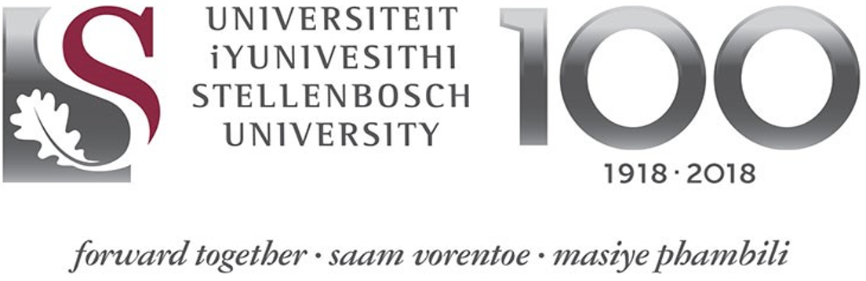

SESSION 2:
Key lessons for understanding the development impact of CDRF in achieving the Sustainable Development Goals
Prof. RANDRIANALIJAONA Tiana Mahefasoa
Disaster Risk Governance and Sustainable Development Economist
Development Centre of Economic Studies and Research
University of Antananarivo - Madagascar
CLIMATE & DISASTER RISK FINANCING ONLINE TRAINING
CLIMATE & DISASTER RISK FINANCING ONLINE TRAINING
SESSION 2:
Key lessons for understanding the development impact of CDRF in achieving the Sustainable Development Goals
Prof. RANDRIANALIJAONA Tiana Mahefasoa
Disaster Risk Governance and Sustainable Development Economist
Development Centre of Economic Studies and Research
University of Antananarivo - Madagascar

Slide 2
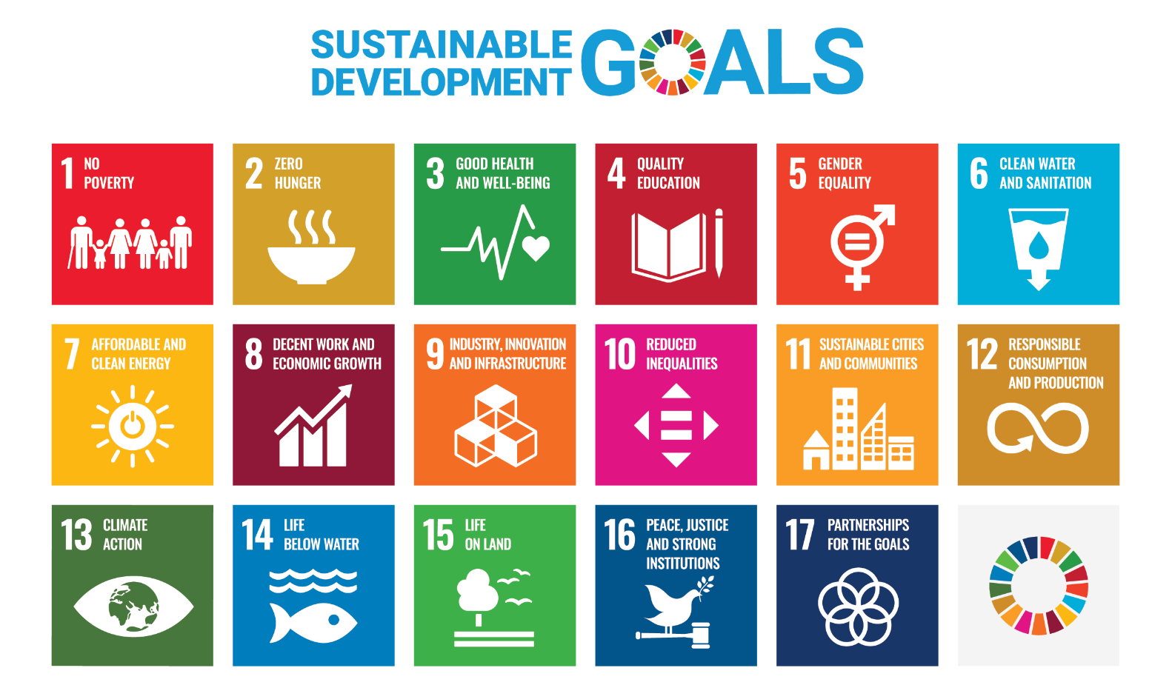
The 17 Sustainable Development Goals (SDGs)
CLIMATE AND DISASTER RISK FINANCING ONLINE TRAINING
SESSION 2: THE DEVELOPMENT CONTEXT & THE SDGs

Slide 3
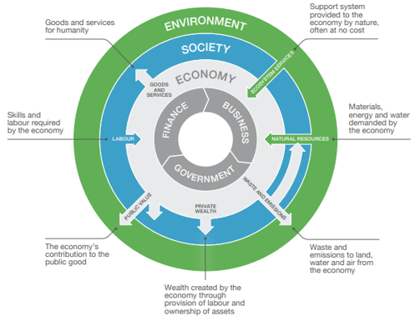
Links between Environment, Society and Government
CLIMATE AND DISASTER RISK FINANCING ONLINE TRAINING
SESSION 2: THE DEVELOPMENT CONTEXT & THE SDGs
Source: CISL (2017)

Slide 4
Links between Environment, Society and Government
CLIMATE AND DISASTER RISK FINANCING ONLINE TRAINING
SESSION 2: THE DEVELOPMENT CONTEXT & THE SDGs
Crucial we start with a shared conceptual understanding of how the environment, economic and society are linked
Easy to think economy is separate and distinct from society and the environment especially, but in practice there are deep interdependencies
The natural environment is the foundation – providing natural resources and ecosystem services, e.g. a stable climate, rainfall cycles for agriculture - We all depend on the natural environment
Societies have constructed economic systems to provide a means of exchanging goods and services we need

Slide 5
Links between Environment, Society and Government
CLIMATE AND DISASTER RISK FINANCING ONLINE TRAINING
SESSION 2: THE DEVELOPMENT CONTEXT & THE SDGs
Economies are dependent on society’s being able to provide skills and labour
Economic activity in turn has impacts on societies (e.g. wealth creation) and the environment (e.g. pollution)
Recognising interdependencies is key DRF and dev – shock of natural disasters can affect all of these flows of interdependency at once: it should not surprise us that managing disasters is core to managing SD

Slide 6
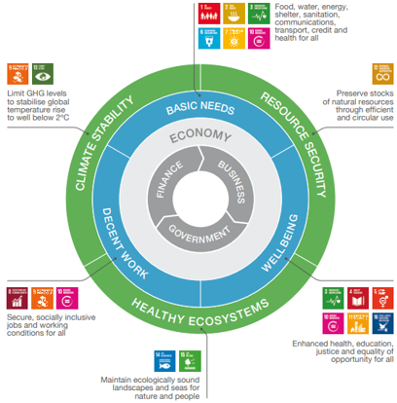
ESG and the SDGs
CLIMATE AND DISASTER RISK FINANCING ONLINE TRAINING
SESSION 2: THE DEVELOPMENT CONTEXT & THE SDGs

Slide 7
East African Example
CLIMATE AND DISASTER RISK FINANCING ONLINE TRAINING
SESSION 2: THE DEVELOPMENT CONTEXT & THE SDGs

Slide 8
Why disasters matter to development
CLIMATE AND DISASTER RISK FINANCING ONLINE TRAINING
SESSION 2: THE DEVELOPMENT CONTEXT & THE SDGs
The concept has two key parts:
    Ecological ceiling for humanity – boundaries beyond which our economic activity is critically undermining the natural environment’s ability to support us
    Social foundations – boundaries beneath which we fail to meet the basic needs of human beings

Slide 9
Why disasters matter to development
CLIMATE AND DISASTER RISK FINANCING ONLINE TRAINING
SESSION 2: THE DEVELOPMENT CONTEXT & THE SDGs
The impacts of a natural disaster and how they undermine the core foundations of development, eroding development gains:
  Housing destroyed
  Clean water disrupted
  Health system overwhelmed or put out of action
  Schools damaged and unsafe for children
Natural disasters can add pressures we put on environmental systems (pollution)
Feedback effects: as we change the climate, we create the conditions for more damaging natural disasters

Slide 10
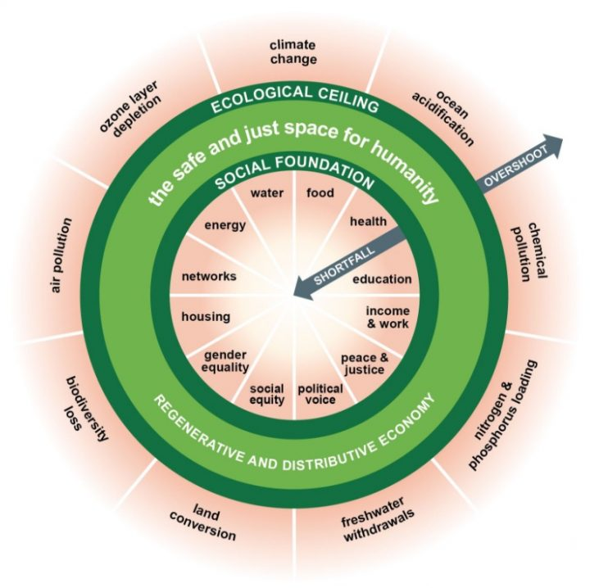
Doughnut Economics – Social Development & Environment
CLIMATE AND DISASTER RISK FINANCING ONLINE TRAINING
SESSION 2: THE DEVELOPMENT CONTEXT & THE SDGs
Source: Raworth (2017)

Slide 11
Discussion
CLIMATE AND DISASTER RISK FINANCING ONLINE TRAINING
SESSION 2: THE DEVELOPMENT CONTEXT & THE SDGs

