Slide 1


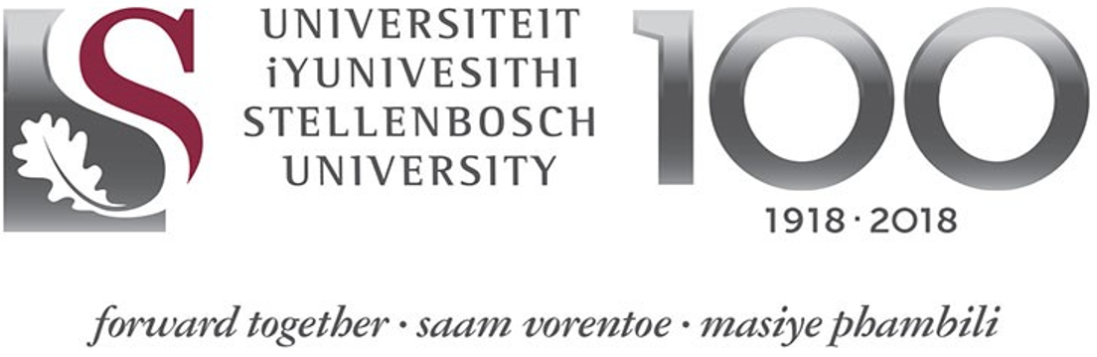

SESSION 2:
Evolving Disaster and Climate Risk Context of Africa
Prof. RANDRIANALIJAONA Tiana Mahefasoa
Disaster Risk Governance and Sustainable Development Economist
Development Centre of Economic Studies and Research
University of Antananarivo - Madagascar
CLIMATE & DISASTER RISK FINANCING ONLINE TRAINING

Slide 2
CLIMATE AND DISASTER RISK FINANCING ONLINE TRAINING
SESSION 1: The Disaster and Climate Risk Context of Africa – Crisis, Financing & the Future
Plan
Observed climate change
Future climate change
Issues at COP 27
Notes:
2

Slide 3
CLIMATE AND DISASTER RISK FINANCING ONLINE TRAINING
SESSION 1: The Disaster and Climate Risk Context of Africa – Crisis, Financing & the Future
TERMINOLOGIES
TIME: instantaneous state of the atmosphere at a given location
CLIMATE: the average state (mean and variability of meteorological parameters) of the atmosphere at a given location during one or more years of observation.
CLIMATE CHANGE: long-term trends (typically decades or centuries) in the mean state of the climate and its variability. Characterized by the shift of the mean and the dispersion around that mean.
CLIMATE VARIABILITY: Short-term variations in climate, including variations associated with global climate events (e.g., El Nino).
GLOBAL WARMING: A gradual increase, expected or observed, in global surface temperature that is one of the consequences of radiative forcing caused by anthropogenic emissions

Slide 4
CLIMATE AND DISASTER RISK FINANCING ONLINE TRAINING
SESSION 1: The Disaster and Climate Risk Context of Africa – Crisis, Financing & the Future
TERMINOLOGIE
NORMAL: Averaged over a uniform and relatively long period (30 years)
ADAPTATION: The accommodation of natural or human systems to actual or expected climatic stimuli or their effects, in order to mitigate their adverse effects or exploit their benefits
MITIGATION: Human intervention to reduce sources or enhance sinks of greenhouse gases
VULNERABILITY: The degree to which a system is susceptible to - or unable to cope with - adverse effects of climate change, including climate variability and extremes
RESILIENCE: The ability to organize and adapt to stress and change

Slide 5
CLIMATE AND DISASTER RISK FINANCING ONLINE TRAINING
SESSION 1: The Disaster and Climate Risk Context of Africa – Crisis, Financing & the Future
CLIMATE CHANGE
Climate change: a slow and sustained change (from a decade to a million years) in the statistical parameters (mean, variability) of climate properties.
These changes may be due to processes intrinsic to the Earth, to external influences or, more recently, to human activities.
Notes:
5

Slide 6
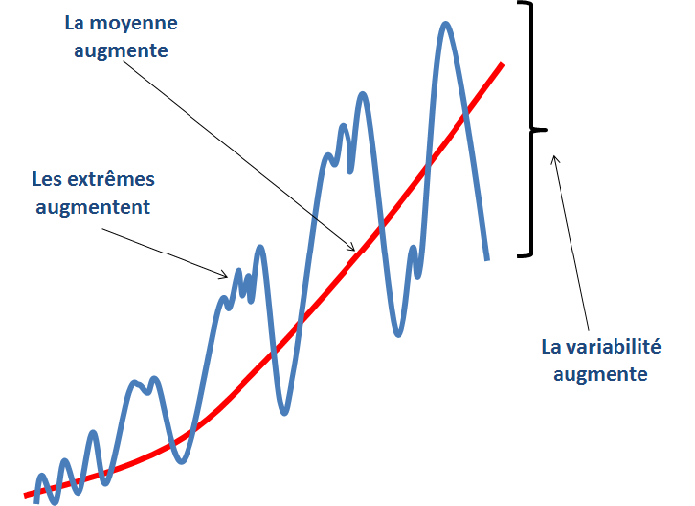
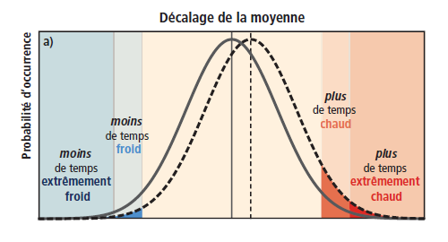

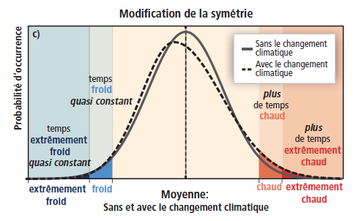
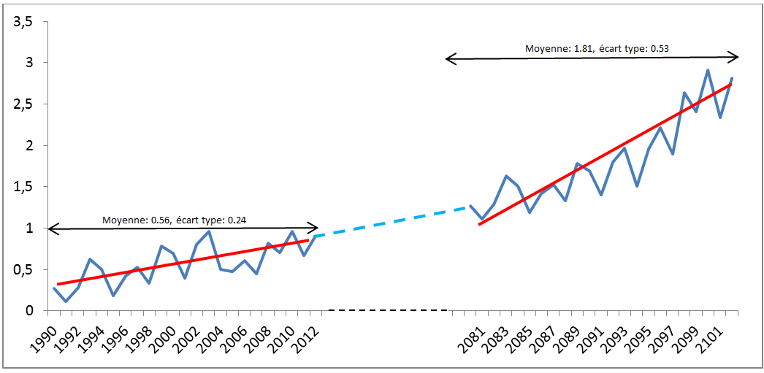
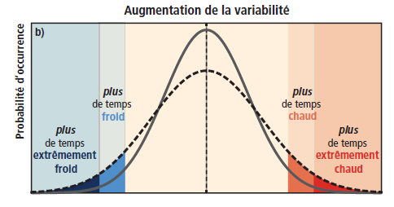
CLIMATE AND DISASTER RISK FINANCING ONLINE TRAINING
SESSION 1: The Disaster and Climate Risk Context of Africa – Crisis, Financing & the Future
The Average increases
The extremes increases
Variability increases
SREX-SPM , GIEC 2012

Slide 7
CLIMATE AND DISASTER RISK FINANCING ONLINE TRAINING
SESSION 1: The Disaster and Climate Risk Context of Africa – Crisis, Financing & the Future
CLIMATE CHANGE OBSERVATIONS

Slide 8

CLIMATE AND DISASTER RISK FINANCING ONLINE TRAINING
SESSION 1: The Disaster and Climate Risk Context of Africa – Crisis, Financing & the Future
EN GÉNÉRAL SUR L’AFRIQUE -AR6 (GIEC)
Mean and extreme temperatures appeared to be above natural variability, relative to 1850-1900, in all continental regions of Africa (high confidence).
The rate of surface temperature increase has generally been faster in Africa than the global average, with human-induced climate change being the dominant factor (high confidence).
The observed increases in hot extremes (including heat waves) and decreases in cold extremes (including cold waves) are expected to continue throughout the 21st century with additional climate warming (high confidence).
Marine heat waves have become more frequent since the 20th century and are expected to increase around Africa (high confidence).

Slide 9


CLIMATE AND DISASTER RISK FINANCING ONLINE TRAINING
SESSION 1: The Disaster and Climate Risk Context of Africa – Crisis, Financing & the Future
EN GÉNÉRAL SUR L’AFRIQUE -AR6 (GIEC)
Relative sea level has risen at a higher rate than the global average sea level around Africa over the past 3 decades. Relative sea level rise is likely to continue around Africa, contributing to increased frequency and severity of coastal flooding in low-lying areas with coastal erosion and along most sandy coasts (high confidence).
The frequency and intensity of heavy precipitation events are expected to increase almost everywhere in Africa with further climate warming (high confidence).
Observed increase in West African monsoonal rainfall during the 20th century due to warming greenhouse gas emissions masked by the cooling decrease in anthropogenic aerosol emissions (high confidence). The observed increase since the 1980s is partly due to the increasing influence of greenhouse gases and the reduced cooling effect of human aerosol emissions in Europe and North America.

Slide 10
CLIMATE AND DISASTER RISK FINANCING ONLINE TRAINING
SESSION 1: The Disaster and Climate Risk Context of Africa – Crisis, Financing & the Future
Evolution of Average Temperatures
Evolution of annual precipitation

Slide 11
CLIMATE AND DISASTER RISK FINANCING ONLINE TRAINING
SESSION 1: The Disaster and Climate Risk Context of Africa – Crisis, Financing & the Future

Slide 12
CLIMATE AND DISASTER RISK FINANCING ONLINE TRAINING
SESSION 1: The Disaster and Climate Risk Context of Africa – Crisis, Financing & the Future

Slide 13
CLIMATE AND DISASTER RISK FINANCING ONLINE TRAINING
SESSION 1: The Disaster and Climate Risk Context of Africa – Crisis, Financing & the Future

Slide 14
CLIMATE AND DISASTER RISK FINANCING ONLINE TRAINING
SESSION 1: The Disaster and Climate Risk Context of Africa – Crisis, Financing & the Future

Slide 15
CLIMATE AND DISASTER RISK FINANCING ONLINE TRAINING
SESSION 1: The Disaster and Climate Risk Context of Africa – Crisis, Financing & the Future
FUTURE CLIMATE CHANGE

Slide 16
Average Annual Temperatures
CLIMATE AND DISASTER RISK FINANCING ONLINE TRAINING
SESSION 1: The Disaster and Climate Risk Context of Africa – Crisis, Financing & the Future
The Sahel is warming up more than the global average

Slide 17
Precipitation
CLIMATE AND DISASTER RISK FINANCING ONLINE TRAINING
SESSION 1: The Disaster and Climate Risk Context of Africa – Crisis, Financing & the Future
Rainfall will increase in the monsoon areas

Slide 18
Annual average soil moisture variation
CLIMATE AND DISASTER RISK FINANCING ONLINE TRAINING
SESSION 1: The Disaster and Climate Risk Context of Africa – Crisis, Financing & the Future
In general, the variation in soil moisture follows the variation in precipitation with some differences due to evapotranspiration;
The small absolute variations appear large when expressed in standard deviation in arid areas with little inter-annual variability

Slide 19
With further increases in global warming, changes in extreme hot and cold temperatures, averages and maximum daily precipitation become more important.
CLIMATE AND DISASTER RISK FINANCING ONLINE TRAINING
SESSION 1: The Disaster and Climate Risk Context of Africa – Crisis, Financing & the Future
Projected changes in annual maximum temperature (TXx), annual minimum temperature (TNn), annual average precipitation, and annual maximum daily precipitation (RX1day) at 1.5°C, 2°C, and 4°C of global warming relative to 1851-1900.
The results are based on simulations of the ensemble average CMIP6 multi-model.
AR6 (GIEC 2021)

Slide 20
PROJECTIONS FOR THE SAHEL
CLIMATE AND DISASTER RISK FINANCING ONLINE TRAINING
SESSION 1: The Disaster and Climate Risk Context of Africa – Crisis, Financing & the Future
Higher than global average temperature increase;
Increases in warm extremes (including heat waves) and decreases in cold extremes (including cold waves) are expected to continue throughout the 21st century with additional global warming (high confidence).
Heat wave frequencies are projected to increase (high confidence).
Projected increases in heavy precipitation and rainfall flooding.
Monsoon rainfall is expected to increase over the central Sahel and decrease over the extreme western Sahel. The monsoon season is expected to have a delayed onset and withdrawal.

Slide 21
CLIMATE AND DISASTER RISK FINANCING ONLINE TRAINING
SESSION 1: The Disaster and Climate Risk Context of Africa – Crisis, Financing & the Future
STAKES OF THE COP 27

Slide 22
CLIMATE AND DISASTER RISK FINANCING ONLINE TRAINING
SESSION 1: The Disaster and Climate Risk Context of Africa – Crisis, Financing & the Future

Slide 23
Stabilizing the human-induced global temperature increase requires achieving zero net anthropogenic CO2 emissions
CLIMATE AND DISASTER RISK FINANCING ONLINE TRAINING
SESSION 1: The Disaster and Climate Risk Context of Africa – Crisis, Financing & the Future
Each 1000 GtCO2 of cumulative CO2 emissions probably causes a 0.27°C to 0.63°C increase in global surface temperature with a best estimate of 0.45°C.
Augmentation globale de la température de surface depuis 1850-1900 en fonction des émissions cumulées de CO₂ (GtCO₂)

Slide 24
Limiting global temperature increase to a specific level would mean limiting cumulative CO2 emissions to a carbon budget.
CLIMATE AND DISASTER RISK FINANCING ONLINE TRAINING
SESSION 1: The Disaster and Climate Risk Context of Africa – Crisis, Financing & the Future
Estimations des émissions de CO2 historiques et bilans carbone restants
AR6, 2021

Slide 25
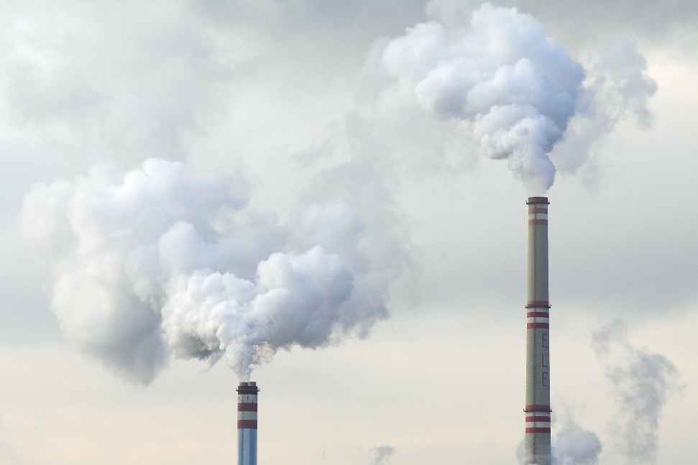
COP 27: BECAUSE EVERY FRACTION OF A °C COUNTS!
CLIMATE AND DISASTER RISK FINANCING ONLINE TRAINING
SESSION 1: The Disaster and Climate Risk Context of Africa – Crisis, Financing & the Future
Future warming depends on future emissions
Current global emissions: 40 GtCO2 /year
To limit to 1.5°C by 2030, carbon budget: 300GtCO2
For carbon neutrality by 2030: we need to quickly and drastically reduce greenhouse gas emissions (CO2, methane etc.)!
We only have a decade to do it!

Slide 26
FUTURE RISK IS GREATER THAN THE IMPACTS ALREADY OBSERVED!
CLIMATE AND DISASTER RISK FINANCING ONLINE TRAINING
SESSION 1: The Disaster and Climate Risk Context of Africa – Crisis, Financing & the Future
Risks of loss of livelihoods and income in rural areas due to inadequate access to drinking and irrigation water, as well as reduced agricultural productivity.
Risks of loss of marine and coastal ecosystems, biodiversity, and the ecosystem goods, functions, and services they provide to livelihoods
Many changes are irreversible beyond 1.5°C of warming!

Slide 27
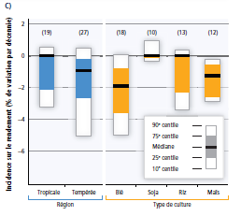
CROP YIELD
CLIMATE AND DISASTER RISK FINANCING ONLINE TRAINING
SESSION 1: The Disaster and Climate Risk Context of Africa – Crisis, Financing & the Future
Impact on Performance (% change per decade)
Region
Type of crop
GIEC, 2014

Slide 28
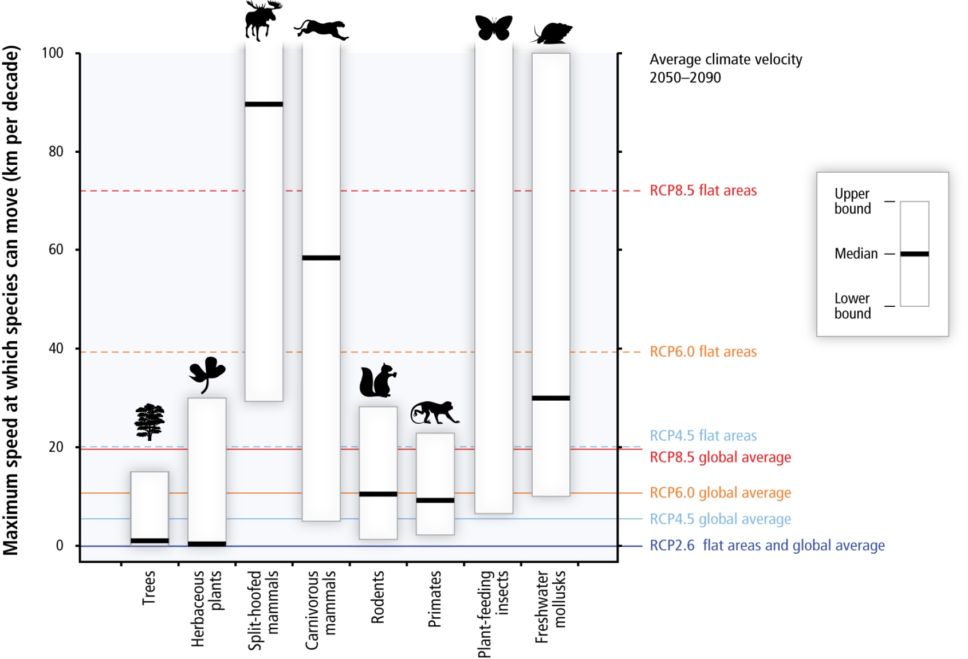
MIGRATION OF SPECIES
CLIMATE AND DISASTER RISK FINANCING ONLINE TRAINING
SESSION 1: The Disaster and Climate Risk Context of Africa – Crisis, Financing & the Future
GIEC, 2014

Slide 29

Merci!
Notes:
29

